Slide 1




PROJECT
MULTI TOOLS DATA CLEANING: DIRTY CAFE SALES DATASET
USING: EXCEL [ FUNTIONS, POWER QUERY], SQL [CTE], PYTHON
By: Farhah
July 2026

Slide 2


DATA PROFILE
Dirty Cafe Sales Dataset is a synthetic dataset containing 10,000 cafe sales transactions across 8 variables: Transaction ID, Item, Quantity, Price Per Unit, Total Spent, Payment Method, Location, and Transaction Date.
The dataset intentionally contains various data quality issues, including missing values, UNKNOWN and ERROR entries, and inconsistencies in numeric and date fields.
It contains 8 menu items: Coffee, Tea, Sandwich, Salad, Cake, Cookie, Smoothie, and Juice. The relationship between Quantity, Price Per Unit, and Total Spent is used as the main business rule for data recovery and validation.
Project Objective: To clean, standardize, validate, and transform the dataset into a clean and analysis-ready dataset.

Slide 3

TOTAL BLANKS & DATA UNIQUE
INFORMATION OF DATA
DATA UNIQUE
Total Colums | 8
Total Rows | 10.000
Item Unique | Payment Method Unique | Location Unique
Coffee | Credit Card | Takeaway
Cake | Cash | In-Store
Cookie | UNKNOWN | UNKNOWN
Salad | Digital Wallet | Blanks
Smoothie | ERROR | ERROR
UNKNOWN | BLANKS
Sandwich
Blanks
ERROR
Juice
Tea
TOTAL BLANKS
 | Total Unknown | Total Error | Total Blank
Item | 344 | 292 | 333
Quantity | 171 | 170 | 138
Price Per Unit | 164 | 190 | 179
Total Spent | 165 | 164 | 173
Payment Method | 293 | 306 | 2579
Location | 338 | 358 | 3265
Transaction Date | 159 | 142 | 159

Slide 4

DATA CLEANING PROCESS
Standardize Missing Values
numeric_cols = [
'Quantity',
'Price Per Unit',
'Total Spent'
]
for col in numeric_cols:
df[col] = (
df[col]
.replace(['UNKNOWN', 'ERROR', ''], np.nan)
)
Data Type Conversion
df['Quantity'] = df['Quantity'].astype('Int64')
Numerical columns were converted into numeric data types, to support further analysis and feature engineering.
Invalid numerical values such as UNKNOWN, ERROR, and blank strings were converted into NaN to make missing values easier to process.

Slide 5

Handling Missing Item
Handling Missing Price
item_map = {
2: 'Coffee',
1: 'Cookie',
5: 'Salad',
1.5: 'Tea' }
item_mask = df['Item'] == 'Unknown'
df.loc[item_mask, 'Item'] = (
df.loc[item_mask, 'Price Per Unit']
.map(item_map)
.fillna('Unknown')
)
price_map = {
'Coffee': 2,
'Cake': 3,
'Cookie': 1,
'Salad': 5,
'Smoothie': 4,
'Sandwich': 4,
'Juice': 3,
'Tea': 1.5
}
price_mask = df['Price Per Unit'].isna()
df.loc[price_mask, 'Price Per Unit'] = (
df.loc[price_mask, 'Item']
.map(price_map)
)
Missing item values were recovered using the corresponding Price Per Unit. For example, a price of 2 was mapped to Coffee, while a price of 1.5 was mapped to Tea.
Missing prices were reconstructed using a predefined price mapping based on the corresponding item.

Slide 6


5. RECOVERING NUMERICAL VALUES
Quantity
df.loc[quantity_mask, 'Quantity'] = (
df.loc[quantity_mask, 'Total Spent'] /
df.loc[quantity_mask, 'Price Per Unit']
)
Total Spent
df.loc[spent_mask, 'Total Spent'] = (
df.loc[spent_mask, 'Quantity'] *
df.loc[spent_mask, 'Price Per Unit']
)
Price Per Unit
df.loc[price_mask_2, 'Price Per Unit'] = (
df.loc[price_mask_2, 'Total Spent'] /
df.loc[price_mask_2, 'Quantity']
)

Slide 7


DATA VALIDATION
SELECT
*,
CASE
WHEN ROUND(quantity * price_per_unit,2)
=
ROUND(total_spent,2)
THEN 'VALID'
ELSE 'INVALID'
END AS data_quality_total_spent,
CASE
WHEN ROUND(total_spent / price_per_unit,2)
=
ROUND(quantity,2)
THEN 'VALID'
ELSE 'INVALID'
END AS data_quality_quantity,
CASE
WHEN ROUND(total_spent / quantity,2)
=
ROUND(price_per_unit,2)
THEN 'VALID'
ELSE 'INVALID'
END AS data_quality_price
FROM remove_null

Slide 8


Cek Duplicate
Remove Null
SELECT COUNT(*) AS total_duplicated
FROM cafe_sales_raw
GROUP BY
transaction_id,
item,
quantity,
price_per_unit,
total_spent,
payment_method,
location,
transaction_date
HAVING COUNT(*) > 1;
cafe_sales = df[
(df['Quantity'].notna())&
(df['Price Per Unit'].notna())&
(df['Total Spent'].notna())
]

Slide 9



Feature Engineering
Excel
A. Funtion
=TEXT(H2,”dddd”)
=TEXT(H2,”mmmm”)
B. Power Queri
Date.DayOfWeekName([Transaction ID])
Date.MonthName([Transaction ID])
SQL
feature_engineering AS(
SELECT
*,
DAYNAME(transaction_date) AS day,
MONTHNAME(transaction_date) AS month
FROM remove_null
)
SELECT * FROM feature_engineering;
Python
cafe_sales['day'] = cafe_sales['Transaction Date'].dt.strftime('%A')
cafe_sales['month'] = cafe_sales['Transaction Date'].dt.strftime('%B')

Slide 10
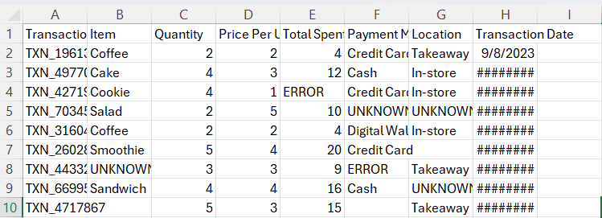
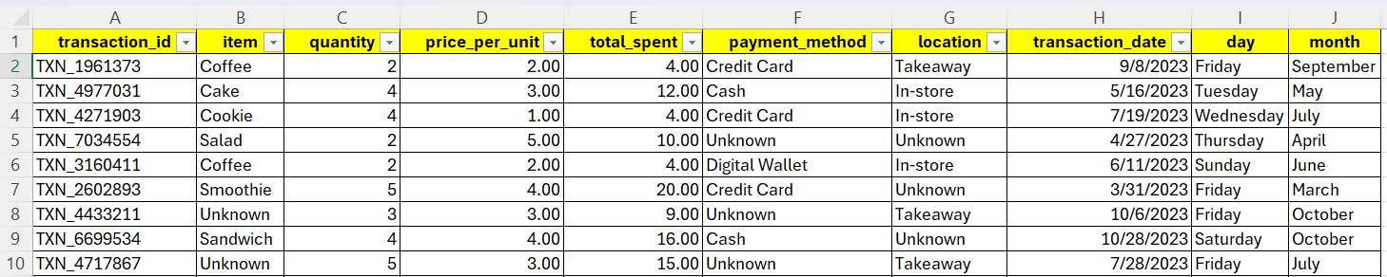
Final Project
Before
Dirty Cafe Sales Dataset was successfully transformed from a raw and inconsistent dataset into a cleaner and analysis-ready dataset. The cleaning process addressed missing values, inconsistent entries, incorrect data types, and incomplete numerical information. Logical relationships between Quantity, Price Per Unit, and Total Spent were also validated to ensure data consistency. The cleaned dataset can now be used for further exploratory data analysis and business insights.
After

Slide 11


Thank You
Farhah S.E.I
Happy-Code-byFarhah
farhahanalytics@gmail.com

